Slide 1
Automatic stair lighting system
in a private residential building

Slide 2
The purpose and objectives of the project
The aim is to develop a microcontroller control system for stair lighting in a private house.
To achieve this goal it is necessary to solve the following tasks:
To consider the state standards, norms and rules of lighting of stairways and placement of necessary components of lighting.
Develop an algorithm for controlling stair lighting.
Choose the technological platform for the implementation of the control device.
Perform programming of the microcontroller control device and mobile application.
Make a layout of the developed device and conduct a demonstration experiment
Notes:
Stairs in a modern multi-storey building are an important part, which, like other rooms, must be thought out in all directions. Lighting is especially important for the stairwell.
Create the right lighting in any room of the house or apartment is quite problematic, as it is necessary to take into account a large number of different factors. In the case of stairs, there are other problems and nuances. One of these nuances is the design and implementation of a lighting system with direct human participation or fully automatic.

Slide 3
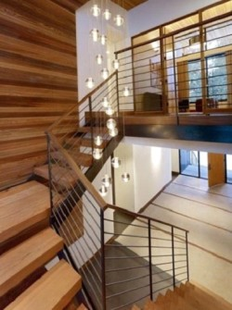
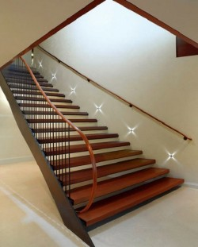
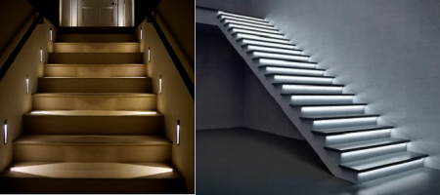
Theoretical aspects of stair lighting
Examples of implementation of options for lighting stairs by subspecies
Natural general and
artificial ambient lighting
Notes:
Before developing and implementing a stair lighting system, it is necessary to understand the norms, rules of organization, current trends and management schemes of stair lighting for a variety of stairs.
In Europe, there are common European lighting standards, dozens of specialized standards, as well as many national rules and regulations.
It is worth considering the types of stair lighting. To date, the lighting of the stairwell may be as follows.
Natural. This type is possible only in a private home. Such illumination of a ladder design is realized by means of window apertures. But in this situation, the light will illuminate the stairs only during the day;
Artificial. Without lighting fixtures, which are sources of artificial light, in the evening or at night to use the stairs is very problematic.
Mixed. In this case, natural light will be combined with artificial lighting. This option for stairs is considered the best
Depending on the species, there are such subspecies of lighting.
General. It is designed to provide full general lighting. The light source in this situation can be a chandelier, which will be placed in the center of the entire structure. The chandelier can be matched to the appropriate style and interior. In addition to chandeliers, general lighting can be created by wall sconces or ceiling spotlights;
Local. By local we mean lighting that illuminates the structure in full. For stairs, it can be arranged built into the wall at the level of the steps spotlights.
There are several options for lighting stairs by subspecies. Each of them has its advantages, but some are recommended only in combination with other options:
The most common option for stair lighting is the usual, top. When luminaires installed under the ceiling emit enough light to illuminate both the stairs and the surrounding space. Refers to the general subspecies of lighting.
The second most popular option is with side lighting stairs. In this case, the lamps are installed on one of the walls adjacent to the stairs and illuminate the stairs and the surrounding space. Both built-in and wall lamps can be used for these purposes.
The next possible option is to illuminate the stairs to the second floor with the help of lamps mounted on the adjacent wall, but at a height not exceeding 30 cm from the steps. Thus, such, usually built-in, lamps, directly illuminate the steps. From the point of view of BNtaP norms it is quite admissible as lighting of stairs is normalized. But for the orientation of man in space, this type of lighting is better to use in conjunction with the types of lighting that give general light.
Another possible option is to illuminate each individual step due to the lamps installed in the next step. These luminaires can be built into each individual step, and can be built into special pads that are installed on the steps. This type of lighting also requires a combination of types of lighting that give general light.

Slide 4
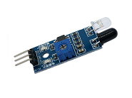
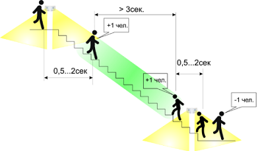
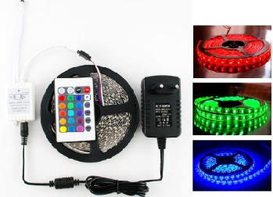
Automatic light control system
Optical IR receiver / transmitter
An example of the implementation of a lighting control system with motion sensors
Modern light source
Notes:
Modern lighting of stairways cannot be imagined without an effective management system. After all, a modern house must be energy efficient. And this is especially true of apartment buildings.
In terms of popularity and practicality, you can automate the lighting control process with a circuit with motion sensors. In this case, you will need a sensor at the beginning and end of the stairs, which when a person appears will work and turn on the lights. After turning on the light, a timer is started, which monitors the duration of its inclusion, and after a while turns it off.
Control of a lighting installation or a separate light fixture is reduced not only to timely switching on or off, but also to a smooth change in the brightness of light sources, all or some. This principle is called "dimming" and means smooth adjustment of light brightness.
Thus, the purpose of dimming is to create static or dynamic light scenes, save electricity and extend the life of lamps (due to the "soft" start and use of economy modes), thereby creating a cozy atmosphere in the room. At the same time the power consumption decreases proportionally.
Remotely controlled dimmers are usually conventional wall-mounted sensor dimmers, equipped with a special overlay with infrared (IR) - receiver or radio receiver. For remote control of panel dimmers, an additional module is used - a radio signal receiver, to which you can connect a remote antenna. The radio-controlled dimmer in the instrument version is a completely autonomous module, which includes a receiving device.
Sensor sensors are used to control light control. For example, motion sensors, or an infrared receiver and an infrared transmitter
An LED is a semiconductor device that generates (when an electric current passes through it) optical radiation, which in the visible region is perceived as monochrome (monochrome). The color of the radiation is determined by both the semiconductor materials used and the alloying impurities. A semiconductor is a material that transmits electric current in one direction. Radiation in these sources is generated not by heating, as in incandescent lamps, and not by electric discharge, as in MGL, but by the release of energy by electrons when current passes through the boundary of metal and semiconductor
Unlike all other light sources, LED radiation does not contain thermal (infrared) and ultraviolet rays. Therefore, LEDs do not heat objects and do not cause them to fade. Their size is very small, which allows you to easily redistribute the light flux in space with reflectors or lenses.
One of the main advantages of LED lighting is its ability to be easily and efficiently controlled. In addition to achieving various visual effects, administration can lead to energy savings and longer service life of LED lighting systems, using various methods to adjust the light intensity.
A much more convenient and common source of light with the simultaneous use of a large number of LEDs is the LED strip - a flexible printed circuit board (assembly), on which, equidistant from each other, the LEDs are located. Usually the width of the tape is 8-20 mm, thickness (with LEDs) 2-3 mm. In the manufacture of the tape is wound into rolls in segments from 1 to 30 m. To limit the current through the LEDs, the electrical circuit of the tape is introduced limiting resistance (resistors), which is also mounted on the tape.
The LED strip operates from direct current and is connected to a direct voltage, usually 12 V, rarely 24 V and 5 V. Therefore, to connect the LED strip to the mains, you also need a DC power supply. LED strips can be monochrome (their LEDs have only one color) and color (standard RGB scheme). For smooth control of brightness and color controllers which principle of work consists in change of brightness of illumination of light-emitting diodes or in change of color are applied. Controllers can be integrated (chip that is inside the RGB LED) and external (chip that is in the case and connects the network to the LED strip). LEDs on the tape with integrated controllers are also called "smart".

Slide 5
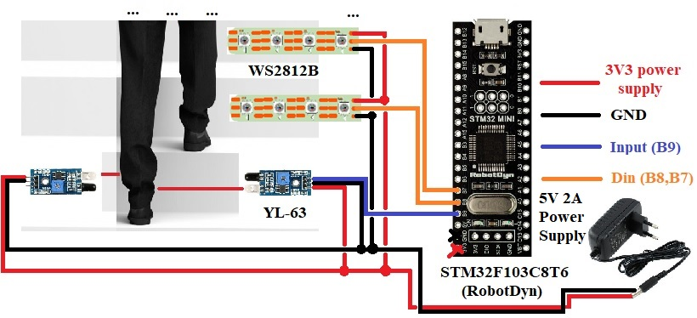
Model of a device for controlling the lighting of stairs in a private residential building
Role in the system | Name | Cost, USD
CD | STM32F103C8T6 (RobotDyn PCB) | 4
Human contact with the system | Optical IR receiver / transmitter YL-63 (x2) | 0.8-0.9
External periphery | WS2812B LED strip | 4-15 for 1m
Control device components
Standard and safer circuit implementation of stair lighting control system in a private house
Notes:
Control of stair lighting in a private house is carried out using a control device (CD), which acts as a microcontroller. The commands that the CD must perform are initiated by a person crossing the first step.
Because the control device is a chip that has special contacts that allow you to receive or provide information to or from the outside world (these special contacts are called I/O ports or pins), there is a possibility due to already developed technologies in the microcontroller (internal peripherals) ), to implement the functionality of the CD in an external way. For example, a foam-connected LED and a specific command or instruction executed by a microcontroller may illuminate it.
Taking into account the technical characteristics of the LED strip (input voltage, rated current consumption of the LED and the length of the strip, which is regulated by the width of the step or the user's wishes), tips for safe connection of the LED strip to the control device. the maximum allowable current MCU), the slide shows the standard and safe circuit implementation of the stair lighting control system in a private house.
A charger for modern smartphones, tablets and portable players, which has identical characteristics to a conventional unit, is also suitable as a power supply. Or a microcontroller port that may be in it.

Slide 6
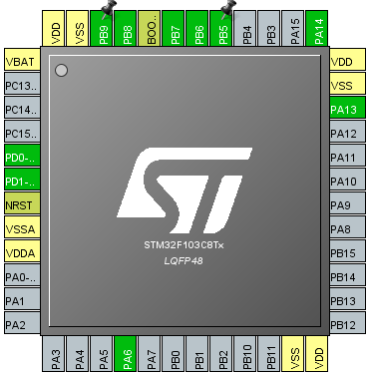
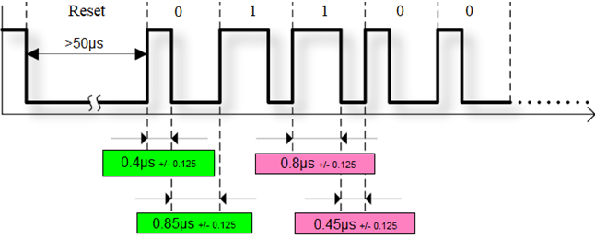
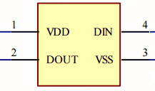
STM32F103C8T6 MCU and WS2812B LED strip
Time characteristics for the implementation of the data transmission protocol (NRZ encoding)
STM32F103C8Tx MCU pinout
Block diagram of the WS2812B LED
6
Notes:
STMicro's STM32F103C8T6 series microcontrollers integrate a Cortex M -M3 32-bit ARM processor with up to 72 MHz, high-speed memory (up to 64 KB FLASH and up to 20 KB SRAM), and a function block for peripherals and I/O lines. All series devices support a standard set of communication interfaces (up to two I2C channels, up to two SPI channels, up to three UART channels, one USB channel and one CAN channel), two 10-bit ADCs, up to six 16-bit general purpose timers and PWM. timer with advanced controls. Microcontrollers are designed to operate in the ambient temperature range from -40 ° C to + 85 ° C at a supply voltage of 2.4 V to 3.6 V. Several modes allow you to create applications with low power consumption.
Areas of application STM32F103: portable equipment, audio-video receivers and digital TVs, PC peripherals, gaming platforms, two-wheeled vehicles with electric drive, home appliances, printers, scanners, alarm systems, video conferencing devices, climate control systems.
Physically, the WS2812B has 3 emitting LEDs (red, blue and green) and PWM drivers that control their brightness. PWM drivers are 8-bit, ie 256 brightness gradations are possible for each of the colors. In order to set the brightness of each of the 3 LEDs, you need to transmit 24 pixels (3 bytes) of information to the pixel. The data transfer protocol uses non-return to zero (NRZ) encoding mode. This is a binary linear code in which ones are represented by one significant condition, usually positive voltage, and zeros are represented by some other significant condition, usually negative voltage, without any other conditions (ie, units and zeros of brightness information are encoded by high and low levels. signal in the line).
The transmission time of one bit is 1.25 microseconds - it's pretty fast. The transmission time of the entire packet for one pixel WS2812B is 30ms. For 1000 pieces - 30 ms (which, for example, allows you to update one line 30x30 pixels with a frequency of 30 times per second).
Each of the pixels WS2812B has 2 power contacts (VDD, VSS), input (DIN) and output (DOUT), which are shown in Fig.4.8. Information (24 bits) is fed to the Din input to display the new color. Color information is transmitted bit by bit (starting with the high bit) sequentially for each of the components of the colors G, R, B.

Slide 7
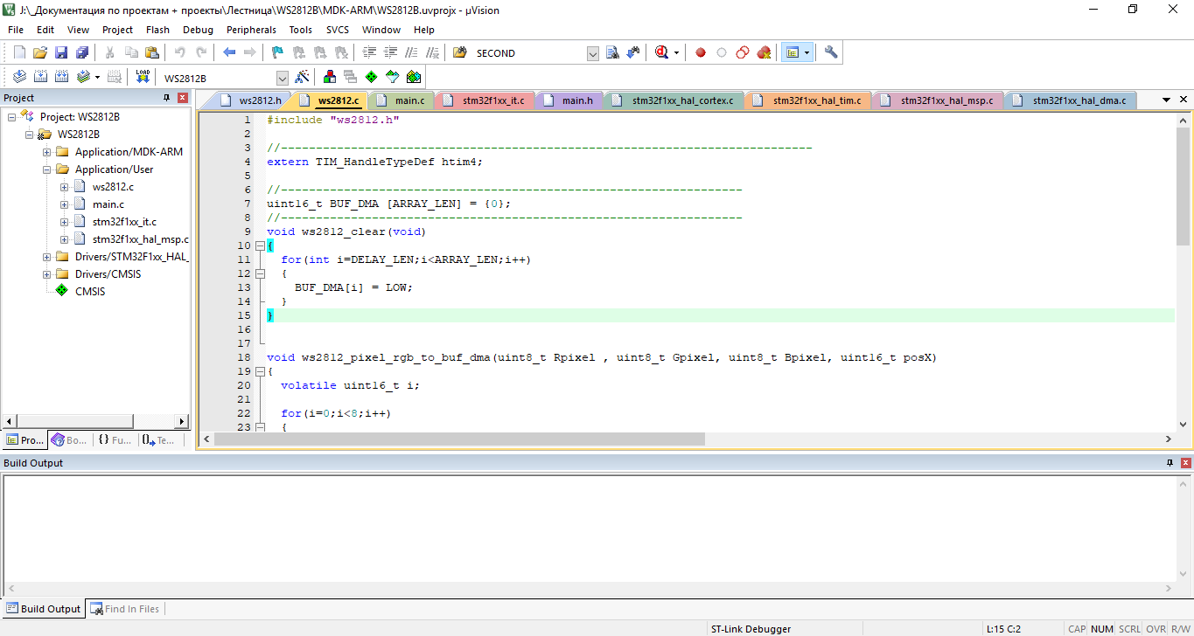
Keil for ARM IDE
The main components of the development environment
1. Database of microcontrollers, which contains detailed information about all supported devices.
2. Project manager, which is used to combine individual texts of software modules
3. Built-in editor that makes it easier to work with source text through the use of multi-window interface,
4. Tools for automatic compilation, assembly and layout of the project, designed to create a boot module of the program.
Notes:
The Keil development environment is a set of utilities for a complete set of microcontroller software writing activities.
Keil allows you to work with projects of any complexity, from input and correction of source code and ending with in-circuit code debugging and microcontroller programming. Most of the minor features are hidden from the developer, which greatly unloads the interface and makes management intuitive. However, as the complexity of the implemented tasks increases, it is always possible to use the full potential of the modules operating under the control of a single shell.

Slide 8
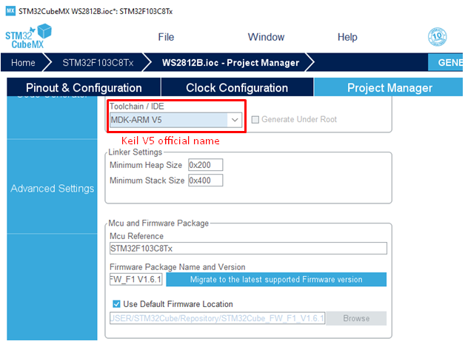
STM32CubeMX CAD
CubeMX graphical tool window to start code generation and IDE selection
8
Notes:
All settings for the software implementation of the control device are in STM32CubeMX (CubeMX). It is a graphical tool that makes it very easy to configure STM32 microcontrollers and microprocessors, as well as generate the appropriate initialization code C for the Arm® Cortex®-M kernel or partial tree of Linux® devices for the Arm® Cortex®-Kernel), in a step-by-step process. One of the advantages of this tool is that the code is generated to the IDE, which is selected by the user.
After generating the code, the user has the opportunity to immediately go to the IDE and start editing the code or immediately sew the software implementation into the microcontroller.
The code generated by CubeMx uses the HAL (Hardware Acceleration Layer) library.

Slide 9
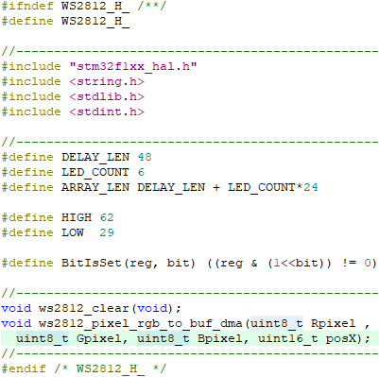
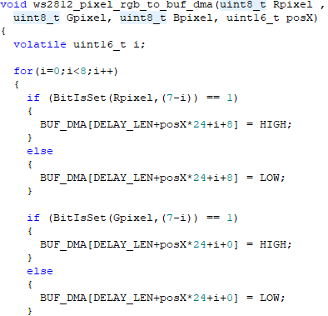
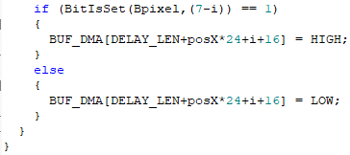
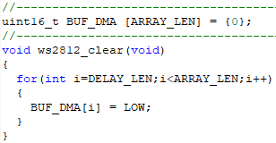
Software code for the implementation of the data transmission protocol for LED tape
Notes:
The implementation program of the railway crossing control device based on the STM32F103C8T6 microcontroller is made in the C programming language in the Keil for ARM development environment.
The main task of the software model is to activate the LED strips, ie to illuminate the stairs.
The LED strip on the WS2812B has only one digital input - Din, connected to the first LED on the strip. A special pulse sequence encoding bits is applied to it. Each LED has one digital output - Dout is connected to the Din input of the next LED on the strip. Each LED needs to transmit 24 bits (8 bits for each color: red R, green G and blue B). Thus, to turn on all the LEDs you need to transmit 24 * N bits, where N is the number of LEDs on the strip.
Since the LED strip works according to some protocol, you first need to design it, as there are no ready-made and implemented solutions. To do this, follow these steps:
Create and initiate a buffer that will store data for each LED in the tape (packets for the entire number of LEDs involved in each tape).
Measure the number of clocks to transmit a logical zero and a logical unit so as not to spoil a given sequence of bits. For the most accurate data transfer it is necessary to use the following rule: the number of clocks in CubeMX + 2.
Create and describe the procedure for filling the package.
The procedure for filling the data buffer is simple to implement, but quite extensive, as it involves filling each bit of data for each color (8 bits in 3 colors) with a mandatory check of which bit came - zero or one. Also, this function fills only one LED per call.

Slide 10
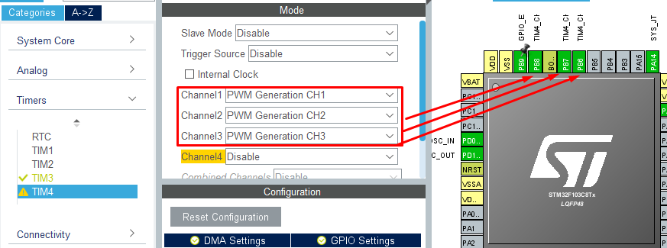
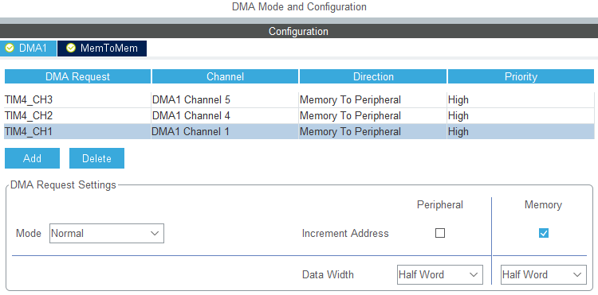
DMA configuring
Connecting ports to implement DMA technology
Special DMA channel settings
Notes:
To minimize CPU time, the software implementation uses direct memory access (DMA) technology. This is a technology that allows some hardware subsystems to access main system memory (random access memory - RAM) independently of the microcontroller processor. This technology is useful at any time when the processor cannot run at an equivalent data rate, or when it is necessary to perform work while waiting for relatively slow I / O (I / O) data transfer.
The advantage of direct access to memory is to minimize the use of microcontroller resources or completely eliminate its participation in data transmission to interact with other microcontroller systems (timers, interrupts, I / O ports, analog-to-digital converter (ADC), etc. .e.).
However, this mechanism still affects the processor. As shown in Figure 5.2, its operation is somewhat slowed down. Because it shares with RDP shared access to RAM and system bus. But measurements have shown that this slowdown in this case does not exceed 0.2%.
To include the technology in the software implementation of the system, it is necessary to implement all the settings and code that are displayed on the slide.
The beginning of color display on LED strips occurs by means of certain step-by-step actions. The first action is a message from the microcontroller about the intersection of infrared sensors in the form of an event or interruption from the external periphery.
An interrupt is a signal that notifies the processor of an event that requires immediate attention. The processor must respond to this signal by interrupting the execution of current instructions and passing control to the interrupt handler (ISR, Interrupt Service Routine). A handler is a common procedure written by a developer whose task is to respond to an event. That is, perform certain operations or instructions for the correct further operation of the system.

Slide 11
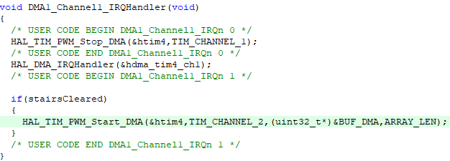
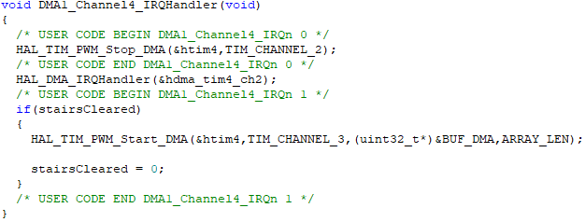
DMA code realization fragment
Notes:
При програмній реалізації пристрою керування автоматичним залізничним переїздом реалізується функція обробки подій.
Обробник події EXTI3_IRQHandler відповідає за відкриття шлагбаума за наступним алгоритмом. Підтвердженням того що поїзд проїхав частину колії, на якій знаходяться датчики розпізнання руху, є виключення обох датчиків D1 та D2 (імітація, виконана за допомогою перевірки відсутності сигналів від двох кнопок (BUTTON_CROSS == OFF && BUTTON_CROSS_END == OFF)). Також, варто зауважити, що даний обробник подій починає свою роботу після того, як буде натиснута та відтиснута кнопка BUTTON_CROSS_END (це вказує на виклик обробника зовнішньої події по задньому фронту). Після перевірки на виконання умови, необхідно перейти у стан TRAIN_CROSS_END, який дає команду на відкриття шлагбаума, але світлове та звукове оповіщення повинні ще працювати. На виконання цих дій необхідний час, тому даний обробник має свою операцію присвоєння нової затримки та пряму передачу її значення у регістр таймера (для зручного користування регістром використовується макрос SET_DELAY).

Slide 12
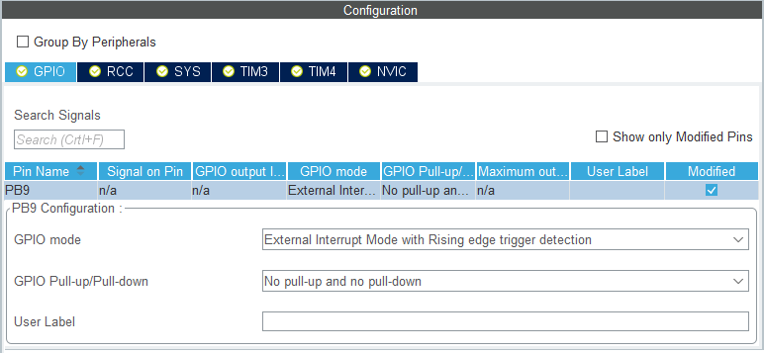
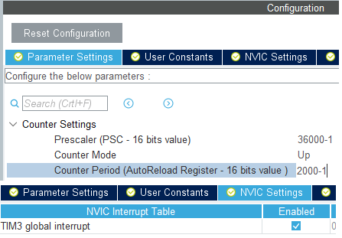
Adjustment of the beginning of work of KP from
the IR sensor of section of a step
Permission to create an interrupt pattern from the sensor
Initialize TIM3 timer settings and allow interrupt template creation
Notes:
The beginning of color display on LED strips occurs by means of certain step-by-step actions. The first action is a message from the microcontroller about the intersection of infrared sensors in the form of an event or interruption from the external periphery.
An interrupt is a signal that notifies the processor of an event that requires immediate attention. The processor must respond to this signal by interrupting the execution of current instructions and passing control to the interrupt handler (ISR, Interrupt Service Routine). A handler is a common procedure written by a developer whose task is to respond to an event. That is, perform certain operations or instructions for the correct further operation of the system.
The handler of this interrupt initiates the operation of the timer TIM3 and its own interrupt handler, which is called when the timer overflows (after a certain number of cycles, which is set by the developer in CubeMX).

Slide 13
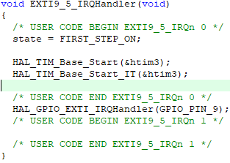
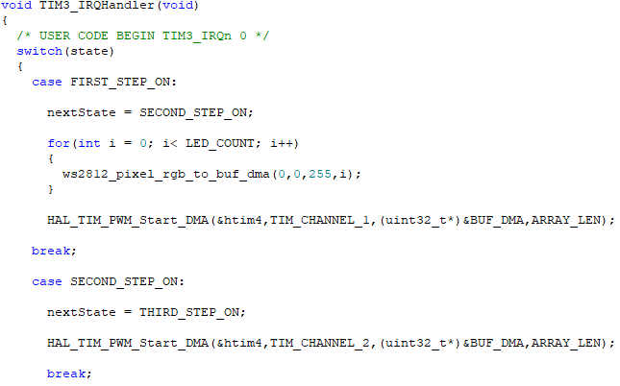

Програмний код реалізації переривань (1)
Notes:
LED strips are switched on and off with the help of automatic programming technology. The automatic template allows you to concisely and best describe the step-by-step logic of the device. As a description of the automatic template, SWITCH-technology is proposed, designed for algorithmization and programming of logical control tasks.
Among all the set of control devices can be distinguished logic control devices, in which control signals (control value) are represented in binary alphabet. Because the implementation of the control part in such devices, as a rule, use limit machines, they are called control machines (SP). Such devices are widely used in control systems for railway transport.
The behavior of logical control systems is also called object-dependent behavior. State - a set of parameters of a complex system at a given time. The current state contains all the information about the past of the system, necessary to determine its response to any input action that is formed at a time. The state can be considered as a special characteristic, which implicitly combines all the input actions of the past that affect the reaction. The response of the system in this terminology depends only on the input action and the current state.

Slide 14
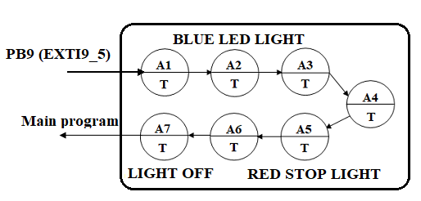
FSM graph
/* USER CODE BEGIN Private defines */
#define FIRST_STEP_ON 1
#define SECOND_STEP_ON 2
#define THIRD_STEP_ON 3
#define FIRST_STEP_OFF 4
#define SECOND_STEP_OFF 5
#define THIRD_STEP_OFF 6
#define ALL_OFF 7
/* USER CODE END Private defines */
Encoded states of the machine
Notes:
BLUE LED LIGHT and RED STOP LIGHT are a text display of the initial values ​​in states A1-A3 and A4-A6, which describes the glow color of all LED strips when a person is present on each of the steps and no person is on the step he has already crossed.
LIGHT OFF is a text display of the original value in state A7, which describes the switching off of all LED strips until the next moment of crossing the steps.
To fully describe the automatic template, you must declare and create data about the hardware components used in it and data about the current and next state.

Slide 15
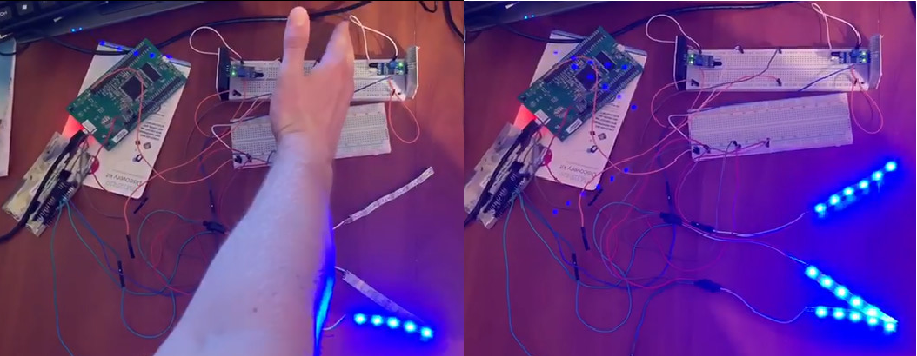
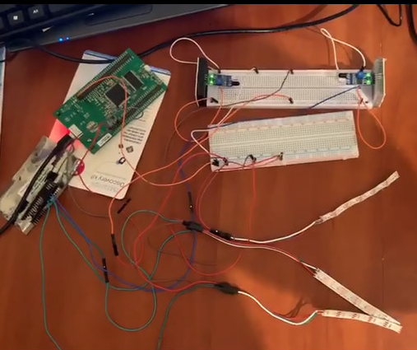
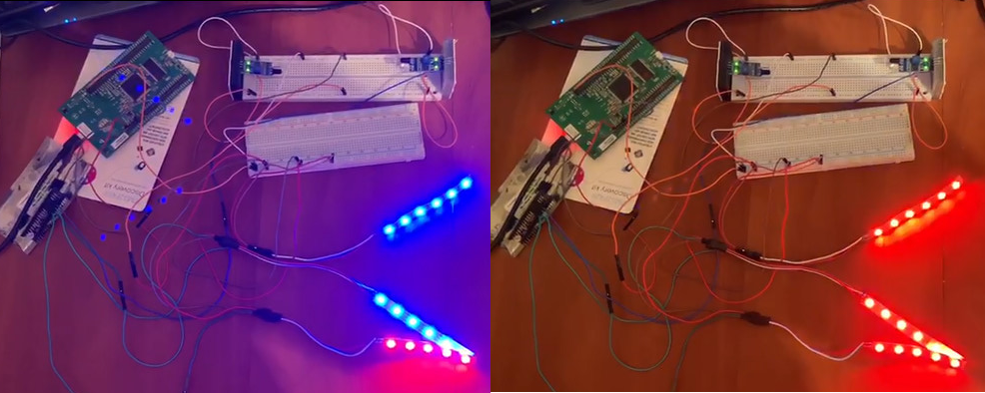
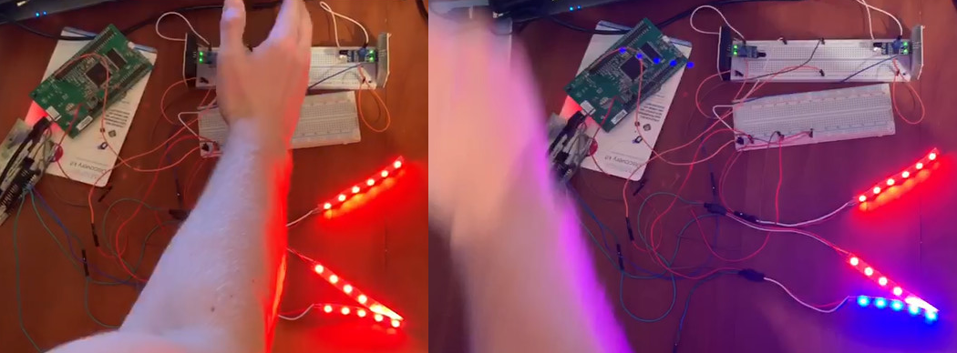
Prototype of the stair lighting control device and demonstration experiment
Turn on the stairs
A red color that warns another person
The moment another person climbs the stairs while the first one has just completed the ascent or continues it
General view of the layout based on the debugging board STM32
Notes:
The operation of the system begins with the connection of the device to a voltage source (3.3V-5V), which feeds the control device, infrared sensors of the intersection of the steps and LED strips. Connecting to a voltage source is also a sign that the system is in its original state. That is, the system is in a state of waiting for the intersection of the steps.
When crossing the stairs, the beam between the infrared sensors is interrupted, there is a voltage on the information port, which is connected to the MK and the lighting of the stairs begins. Blue color means permission to safely climb the stairs.
At the end of the intersection of each step, the LED strip changes its color to red. This color warns the other person that after a short period of time the systems will complete the illumination of the stairs.
By default, the steps are turned on and off gradually (one after the other). The color of the steps changes only when all the steps are highlighted with the same color. The time to turn on and change the color of each step is one second. This time can be changed by reconfiguring the timer, i.e. software.
However, if the first person has not yet finished climbing the stairs and the other person (under any circumstances) has started to climb, the system will react immediately to this event and start highlighting the stairs in blue again. Although this mode of operation of the system is implemented specifically, but it should not be used constantly as there is a risk, depending on the setting time of each step does not complete the climb up the stairs until all steps are highlighted in blue.

Slide 16
Conclusions
A microcontroller device for controlling stair lighting based on the principle of full event programming with the implementation of a finite control machine has been developed.
The control unit is implemented on the basis of the microcontroller family STM32 (STM32F103C8T6). The software implementation of the control algorithm is carried out in the C programming language in the Keil development environment and with the help of CubeMx CAD.
Based on the protocol of data transmission according to official documentation and the use of modern solutions for interaction with RGB-LEDs, the connection between the MC and the LED strip was implemented using DMA technology to minimize the hardware costs of the microcontroller.
The prototype of the stair lighting system in a private residential building is implemented on the basis of a simplified circuit implementation using LED strip based on WS2812B LEDs using a debug board STM32.

